Slide 1

HR Employee
Attrition
Prediction
Stage 1 Report
Data preparation, EDA, feature engineering, and model-ready dataset.
Final Project Report
Presented by PBHI Solutions

Slide 2


Slide 3

Table Of Content
1
Final Dataset & Data Quality
2
Exploratory Data Analysis
3
Top 5 Potential Key Drivers
4
Feature Selection & Engineering
5
Data Transformation & Final Output
PBHI Solutions
Stage 1 Report

Slide 4
Stage 1 Progress Overview
Focus: turn raw HR data into a model-ready dataset for Stage 2 modeling.
01
02
03
04
05
Data Quality
EDA
Key Drivers
Feature Prep
Final Output
Missing, duplicate, constant columns, and outlier checks
Target distribution, univariate, multivariat, and features pattern
Top 5 potential drivers based on EDA evidence
Selection, engineered features, and transformation pipeline
Train/test model-ready matrix with 54 features
PBHI Solutions
Stage 1 Report

Slide 5
Final
Dataset
Dataset Readiness
↗
PBHI Solutions
Stage 1 Report

Slide 6
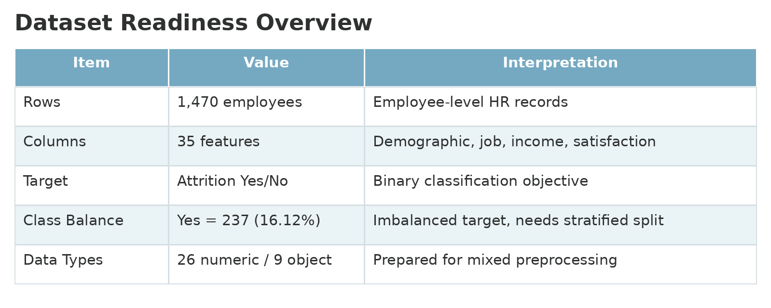
Dataset Readiness
The dataset is suitable for a binary attrition prediction task, with imbalanced target distribution.
Main Message
Rows represent employees, not transactions.
Target is binary: Attrition Yes/No.
Class imbalance exists: Yes only 16.12%.
Stage 1 output must preserve target ratio for modeling.
Why this matters?
Recall and F1 will matter later because missing attrition cases is costly for HR.
PBHI Solutions
Stage 1 Report

Slide 7
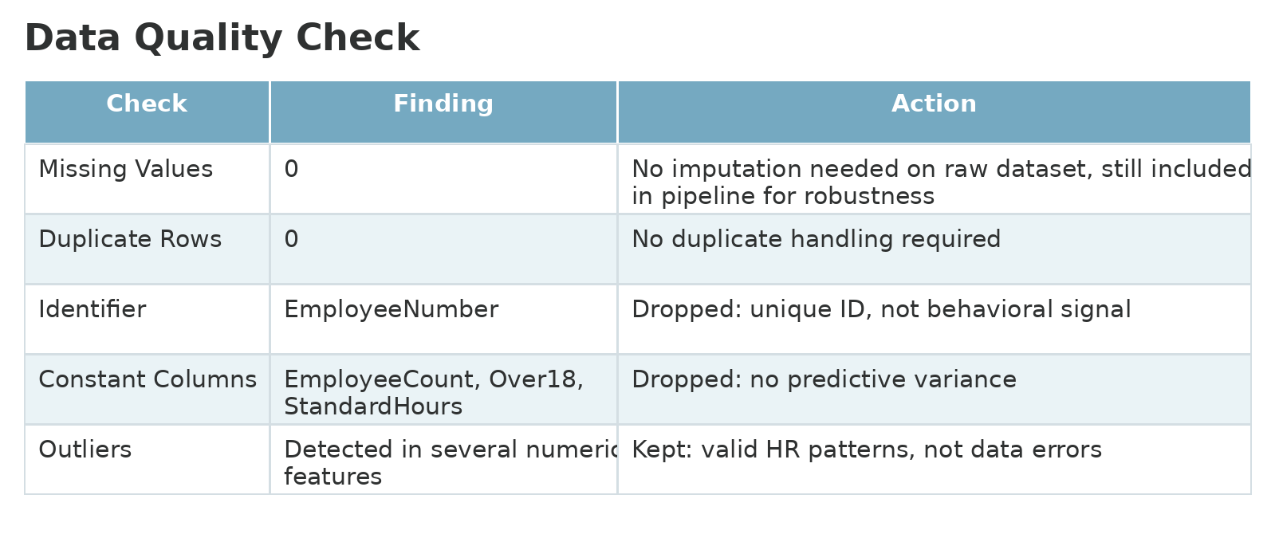
Data Quality Check
Key cleaning decisions before EDA and modeling.
Cleaning decision: keep valid outliers, drop non-informative columns, and make the preprocessing pipeline robust for future data.
PBHI Solutions
Stage 1 Report

Slide 8
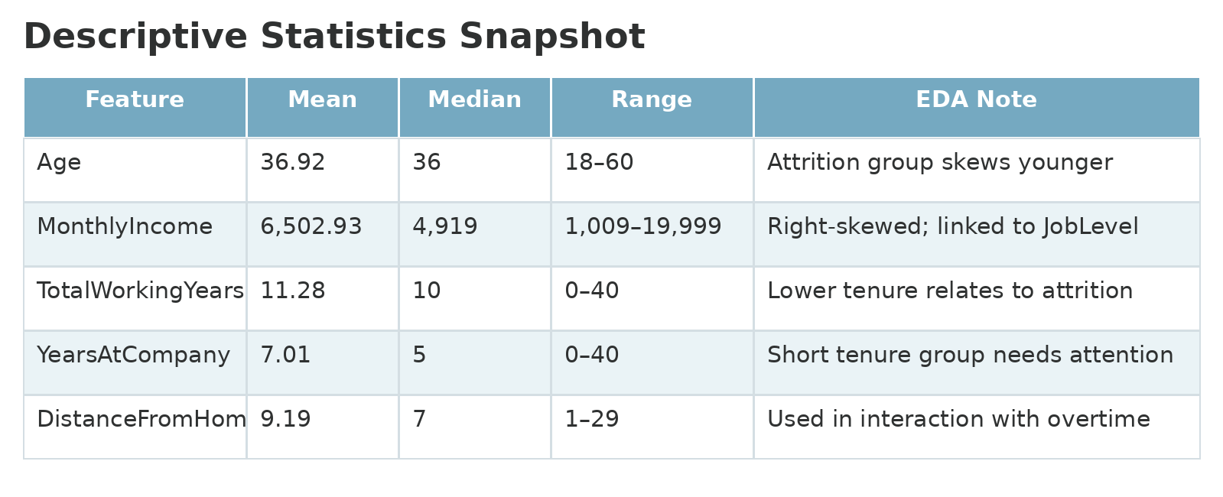
Descriptive Statistics
Python summary table used to understand numeric feature patterns.
EDA Notes
Income and tenure features are right-skewed.
Attrition employees tend to be younger.
Lower tenure and lower income appear in attrition group.
Some numeric variables need scaling before modeling.
PBHI Solutions
Stage 1 Report

Slide 9
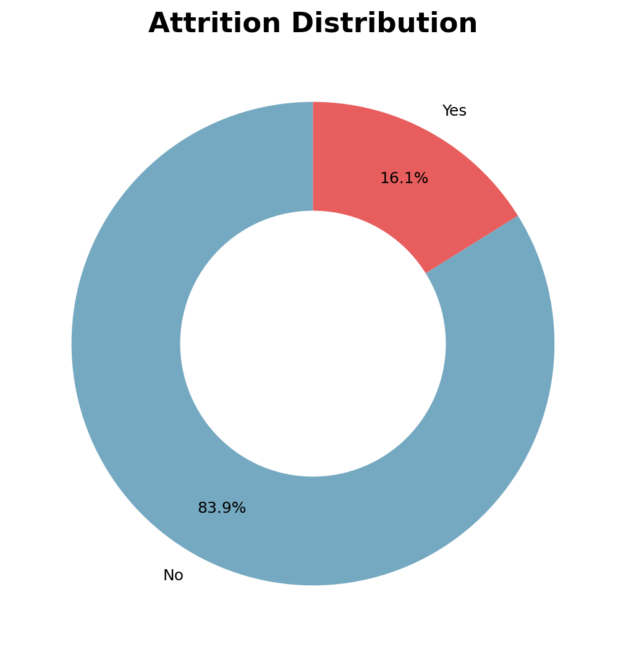
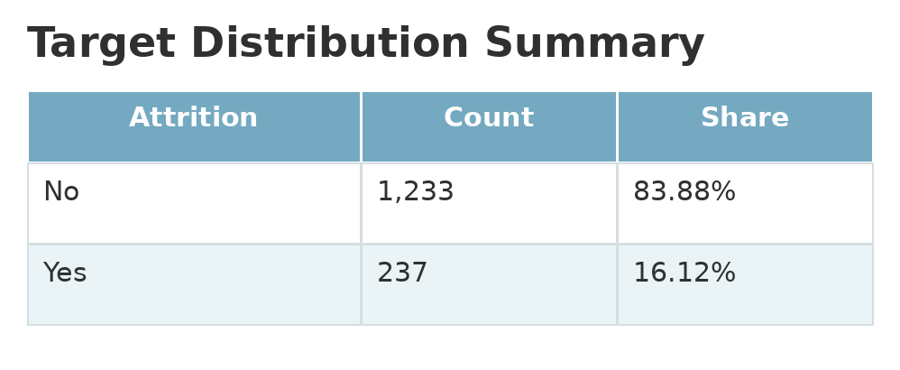
Target Analysis
The target class is imbalanced, so Stage 2 should focus beyond accuracy.
Attrition = Yes is only 16.12% of the data (Imbalance).
PBHI Solutions
Stage 1 Report

Slide 10
Exploratory
Data Analysis
Univariate, Multivariat, & Find Top 5 Keys
↗
PBHI Solutions
Stage 1 Report

Slide 11
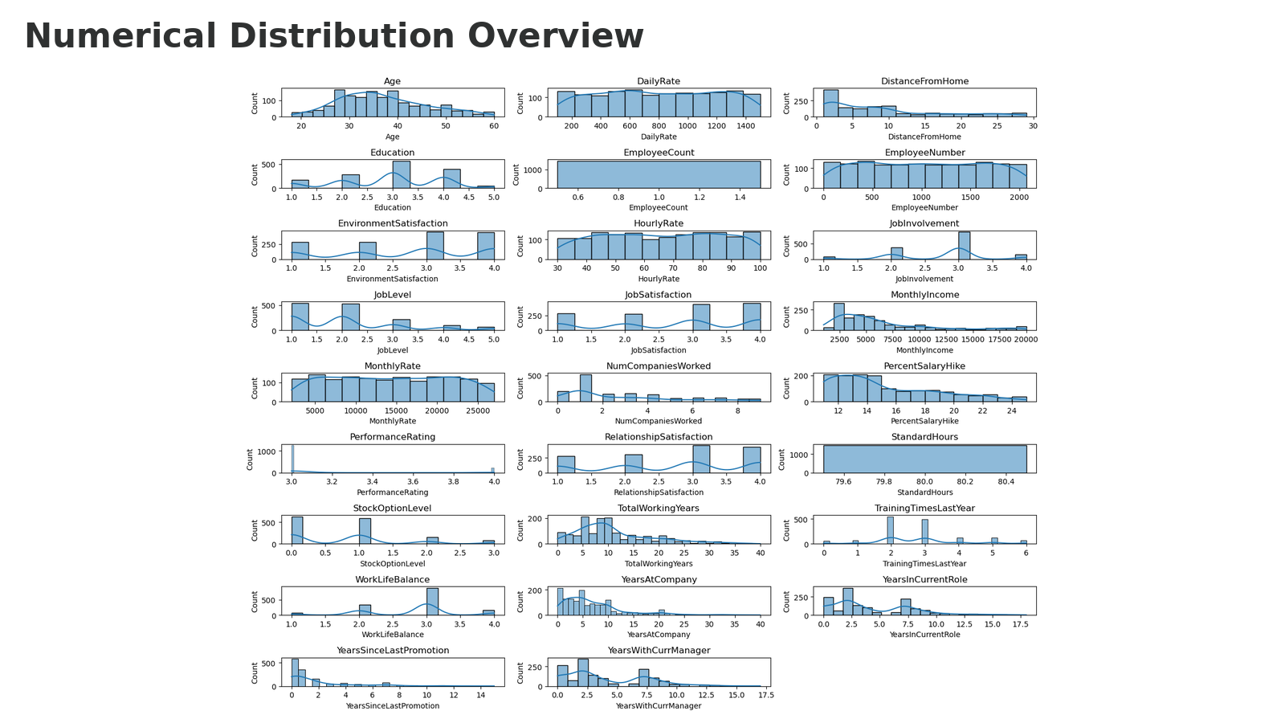
Univariate Analysis
Observations
Several features are positively skewed.
Income and tenure variables have wide ranges.
Scaling is needed before modeling.
Outliers appear valid in HR context.
PBHI Solutions
Stage 1 Report

Slide 12
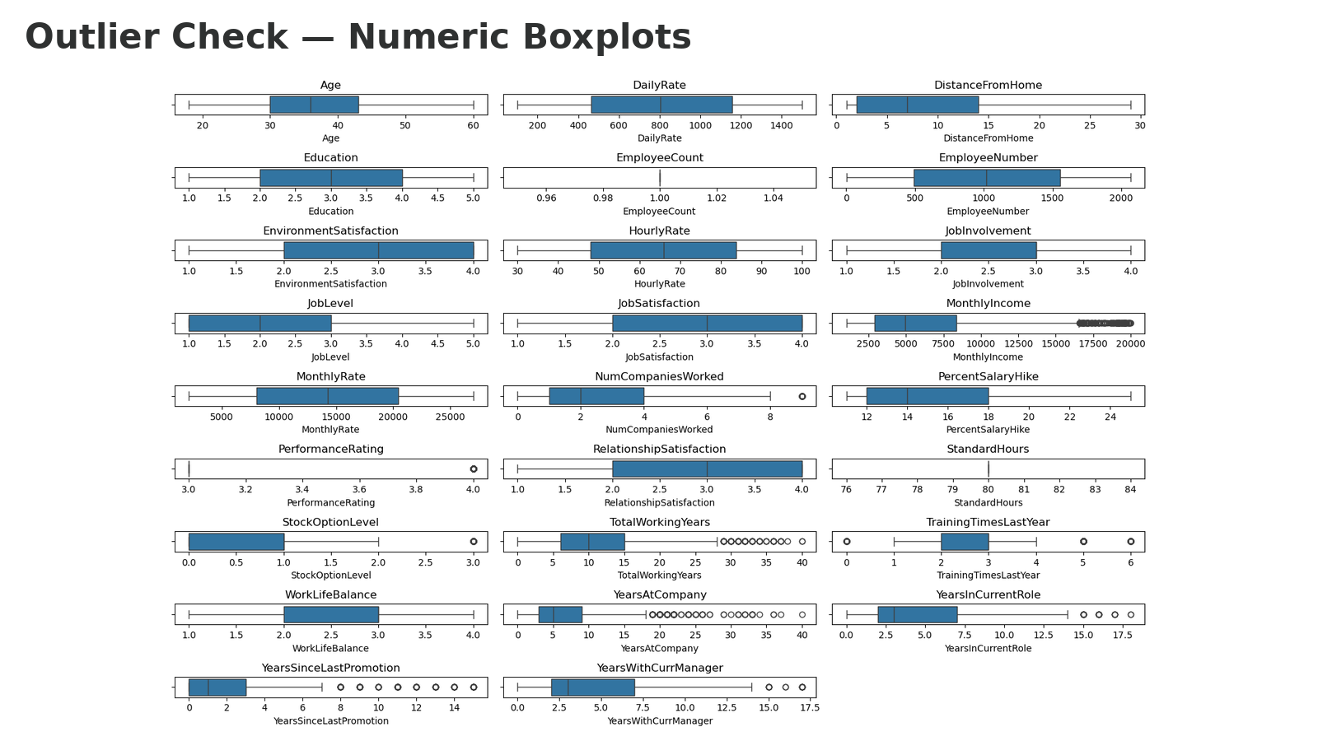
Outlier Analysis
Boxplots are used to identify extreme values in numeric HR features.
Decision: outliers are retained because values such as high tenure, high income, and long promotion gaps can be real HR patterns.
PBHI Solutions
Stage 1 Report

Slide 13
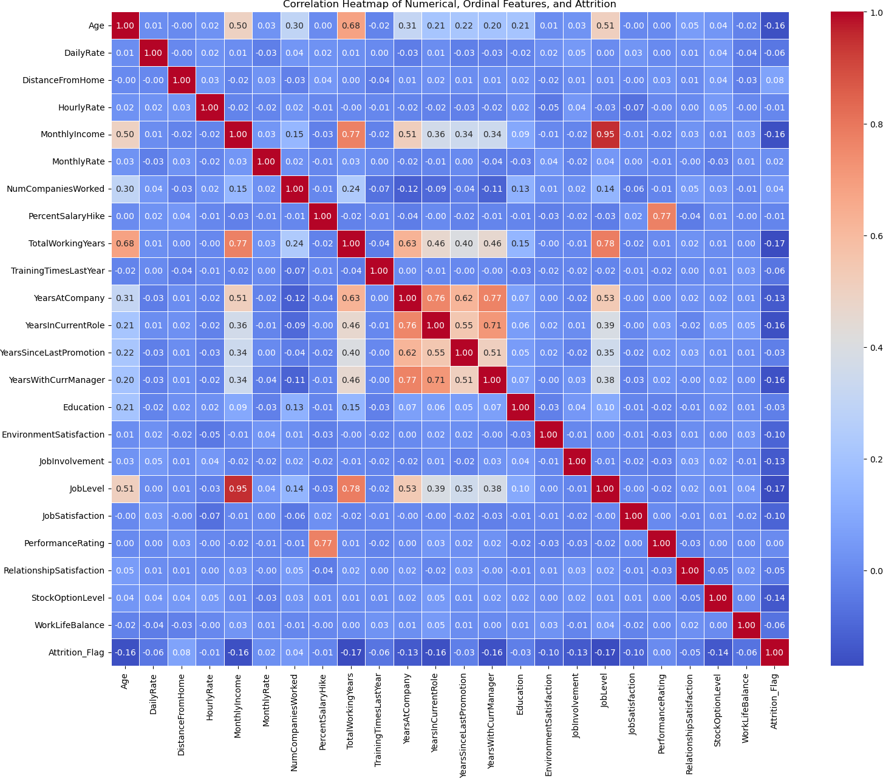
Multivariate Analysis — Correlation Heatmap
Python heatmap enlarged to show multicollinearity and feature redundancy before modeling.
Key risk: highly correlated variables may duplicate information and reduce model.
PBHI Solutions
Stage 1 Report

Slide 14
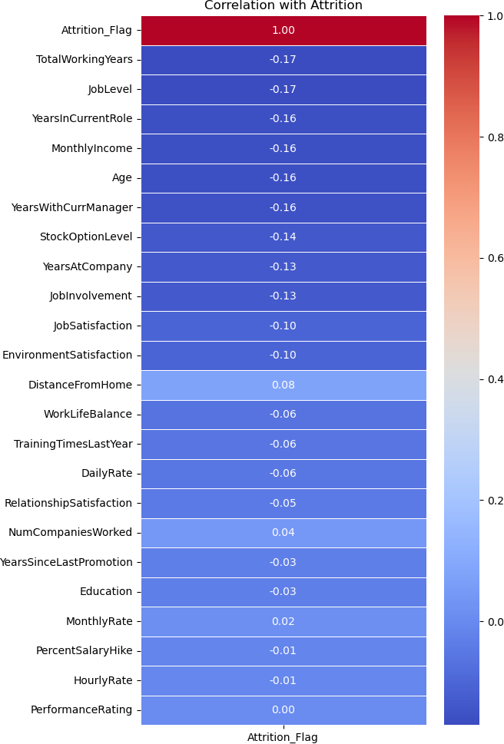
Correlation With Attrition Flag
Target correlation provides early direction, while the notes identify multicollinearity risks.
The correlation heatmap shows that the linear relationship between attrition and all numerical/ordinal features is weak, as all correlation values are below ±0.20. Therefore, no single feature has a strong linear correlation with attrition.
PBHI Solutions
Stage 1 Report

Slide 15
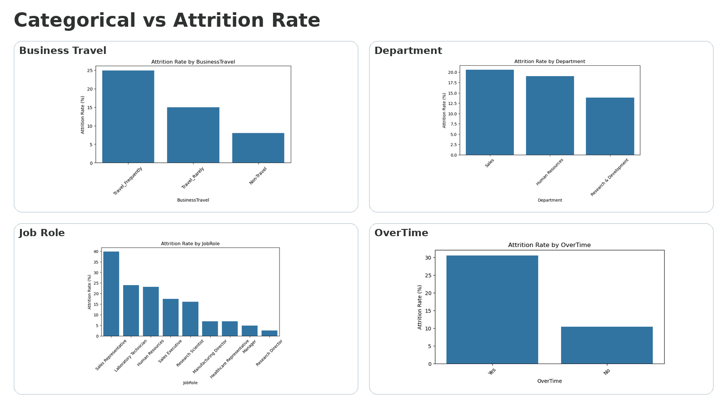
Features and Target Analysis
Python bar charts show attrition-rate differences by categorical segment.
Key signals
OverTime = Yes shows a clear risk gap.
Sales-related roles need attention but segment size matters.
Business travel and department show useful contextual patterns.
PBHI Solutions
Stage 1 Report

Slide 16
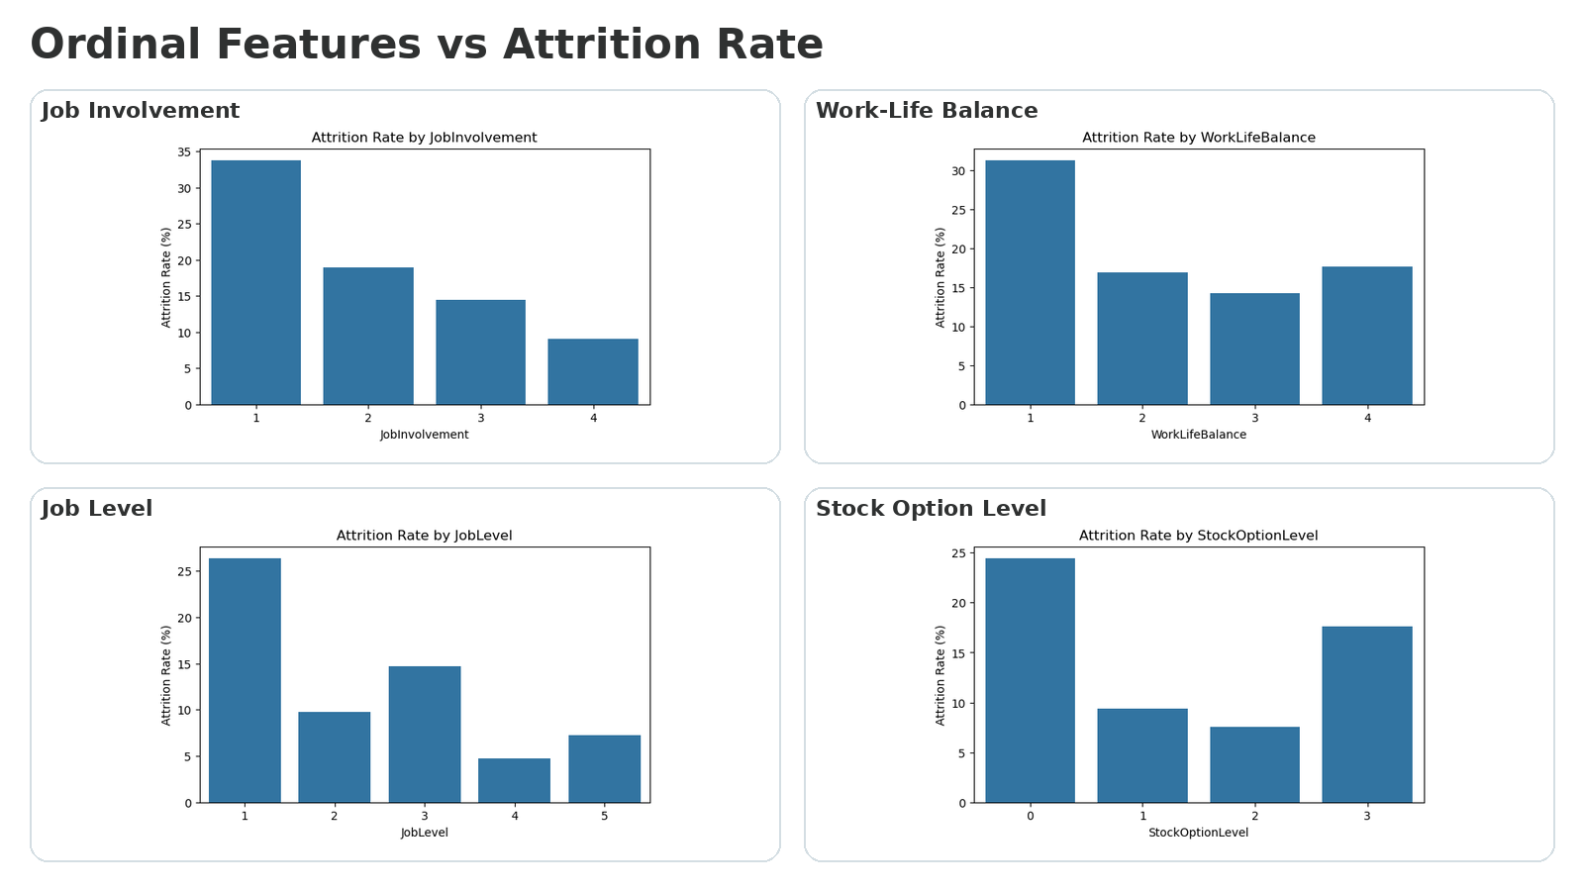
Features and Target Analysis
Low satisfaction, low involvement, and low stock option levels show higher attrition.
Key signals
Low JobInvolvement and low WorkLifeBalance show clear attrition risk patterns.
JobLevel = 1 stands out as a high-risk segment.
StockOptionLevel = 0 has the highest attrition rate among stock option groups.
Ordinal features suggest that lower engagement, lower benefits, and lower job level are associated with higher attrition risk.
PBHI Solutions
Stage 1 Report

Slide 17
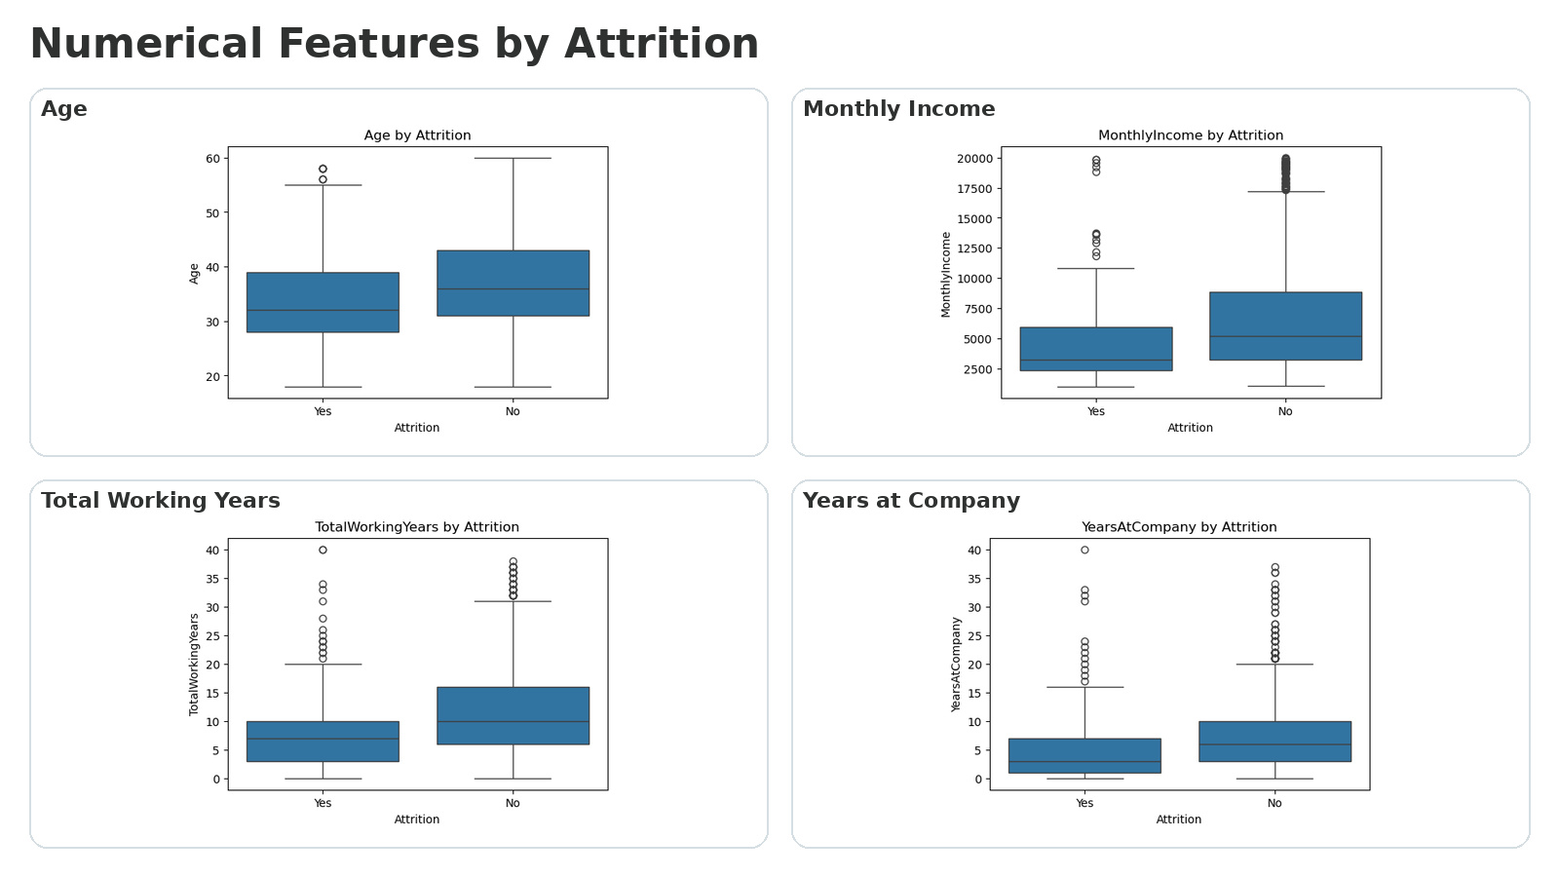
Features and Target Analysis
Boxplots compare attrition and non-attrition groups across numeric features.
Key signals
Younger employees show higher attrition tendency.
Lower monthly income is linked to higher attrition risk.
Employees with shorter work experience are more likely to leave.
Shorter company tenure indicates weaker retention.
PBHI Solutions
Stage 1 Report

Slide 18
Top 5 Potential Key Drivers
Based on EDA findings before model training and SHAP validation.
01
02
03
04
05
OverTime = Yes
JobLevel = 1
StockOptionLevel = 0
MonthlyIncome rendah
Age & Tenure rendah
Attrition rate karyawan overtime mencapai 30.53%, jauh lebih tinggi dibanding non-overtime 10.44%. Segment ini juga menyumbang 127 kasus attrition.
Karyawan level 1 memiliki attrition rate 26.34% dengan 143 kasus attrition.
Karyawan tanpa stock option memiliki attrition rate 24.41% dan menyumbang 154 kasus attrition, jumlah tertinggi di antara segment yang dianalisis.
Karyawan resign cenderung lebih muda dan memiliki masa kerja lebih pendek. Median usia resign 32 tahun vs 36 tahun, dan median YearsAtCompany 3 tahun vs 6 tahun.
Karyawan resign memiliki median MonthlyIncome 3,202, lebih rendah dibanding karyawan yang bertahan 5,204.
PBHI Solutions
Stage 1 Report

Slide 19
Feature
Preparation
Selection, Engineering & Transformation
↗
PBHI Solutions
Stage 1 Report

Slide 20
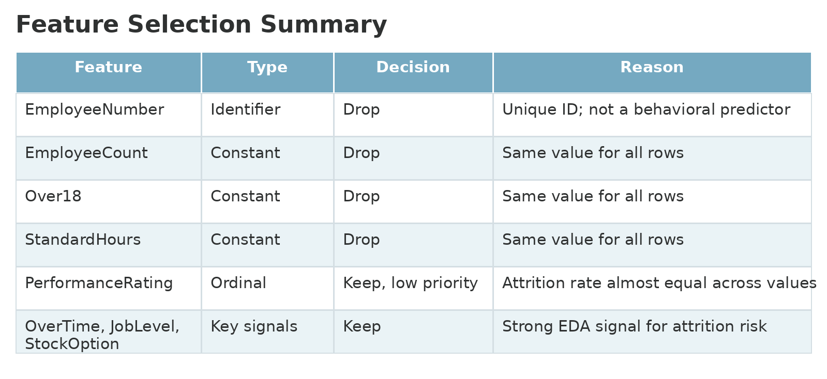
Feature Selection
Drop columns with no predictive signal; keep potential behavioral and compensation drivers.
PBHI Solutions
Stage 1 Report

Slide 21
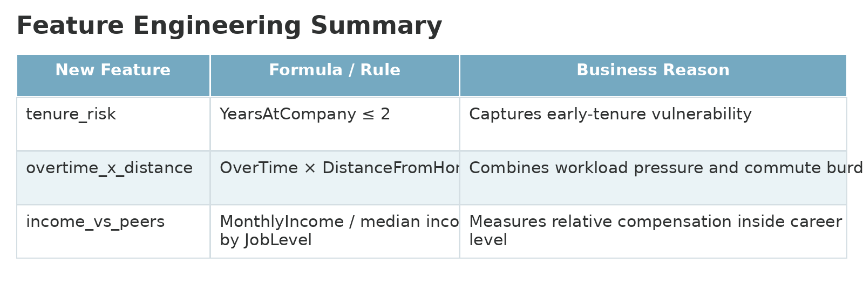
Feature Engineering
New features are created to capture business context beyond raw columns.
Important: income_vs_peers is calculated from training data only to reduce leakage risk.
PBHI Solutions
Stage 1 Report

Slide 22
Data Transformation
This directly addresses scaling, encoding, and imputation before modeling.
Numerical → Median Imputer
1
Median lebih robust terhadap outlier dibanding mean.
Meskipun dataset tidak memiliki missing value, langkah ini tetap disiapkan agar pipeline modeling lebih aman dan konsisten.
3
Numerical → Scaling
Scaling menyamakan skala antar fitur numerik.
Penting untuk model berbasis jarak atau koefisien seperti Logistic Regression, KNN, dan SVM.
Untuk model tree-based, scaling tidak wajib, tetapi tetap bermanfaat dalam preprocessing.
4
5
Categorical → One Hot Encoding
Model machine learning tidak dapat langsung memproses data teks/kategori.
One Hot Encoding mengubah kategori menjadi representasi numerik 0/1.
PBHI Solutions
Stage 1 Report

Slide 23
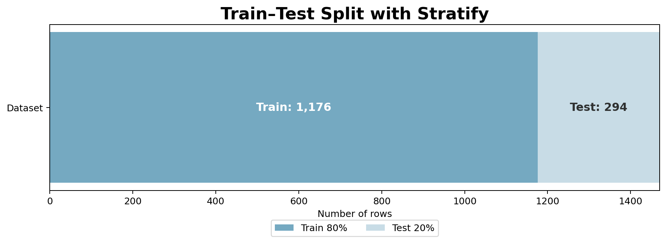
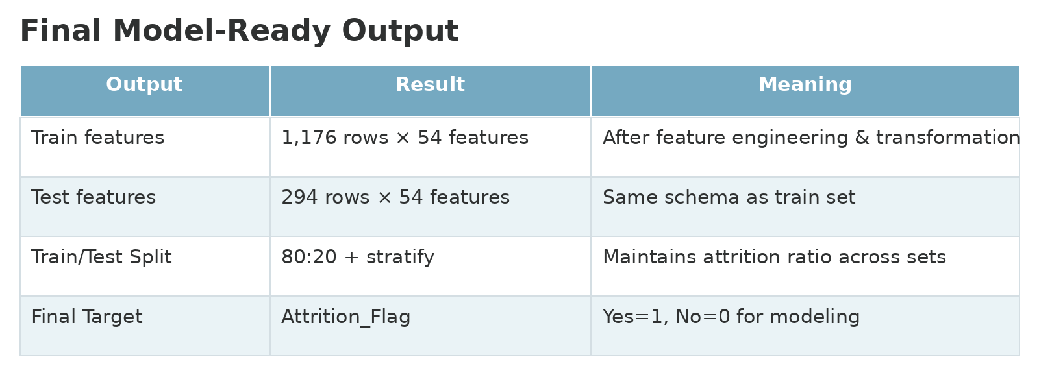
Train-Test Split & Final Output
Final transformed dataset is ready for Stage 2 model development.
Final Output
The final matrix has 54 transformed features in both train and test sets. The train/test split uses stratify to preserve the attrition ratio.
PBHI Solutions
Stage 1 Report

Slide 24
Stage 1 Completeness Check
What has been completed before moving into modeling.
✓
Final Dataset
✓
EDA
Cleaned and selected features are prepared
Univariate, bivariate, and numerical patterns analyzed
✓
Top Drivers
✓
Feature Selection
Top 5 potential attrition drivers summarized
Identifier and constant features removed
✓
Feature Engineering
✓
Transformation
3 business-driven features added
Imputation, scaling, and encoding pipeline defined
Stage 1 is complete and the dataset is ready for baseline modeling in Stage 2.
PBHI Solutions
Stage 1 Report

Slide 25
Key Takeaways
Concise summary for the end of Stage 1.
1
Data is clean
No missing values or duplicates were found in the raw dataset.
2
Attrition is imbalanced
Only 16.12% of employees are Attrition = Yes.
3
Top potential drivers are clear
Overtime, involvement, work-life balance, job level, and stock option require focus.
4
Transformation is ready
Imputation, scaling, and encoding have been defined in a pipeline.
5
Next step: modeling
Stage 2 should test baseline models, tune threshold, and evaluate recall/F1.
PBHI Solutions
Stage 1 Report

Slide 26
Next Steps for Stage 2
Move from prepared data to modeling and evaluation.
1
2
3
4
5
Baseline models
Handle imbalance
Evaluation metrics
Explainability
Thresholding
Logistic Regression, Decision Tree, Random Forest, XGBoost, KNN, etc.
Compare baseline vs class_weight / SMOTE on train only
Recall, F1-score, ROC-AUC, PR-AUC, confusion matrix
Feature importance and SHAP/LIME to confirm key drivers
Select risk threshold based on business priority
PBHI Solutions
Stage 1 Report

Slide 27


